Slide 1


TTbar Differential Cross Section in Fully Hadronic Status Update
K. Kousouris, Y. Tsipolitis, I. Papakrivopoulos, G. Bakas
For NTUA

Slide 2
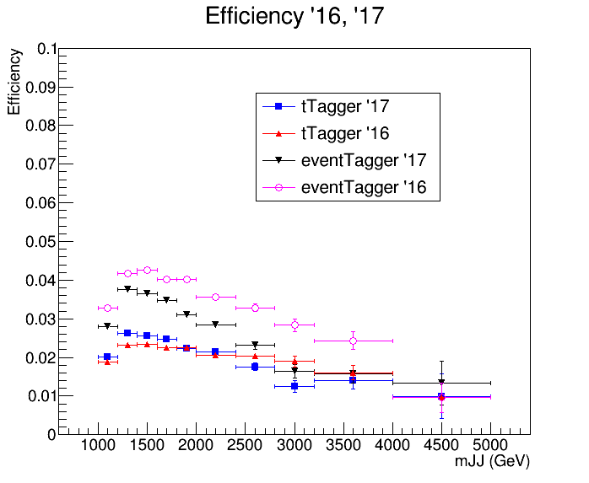
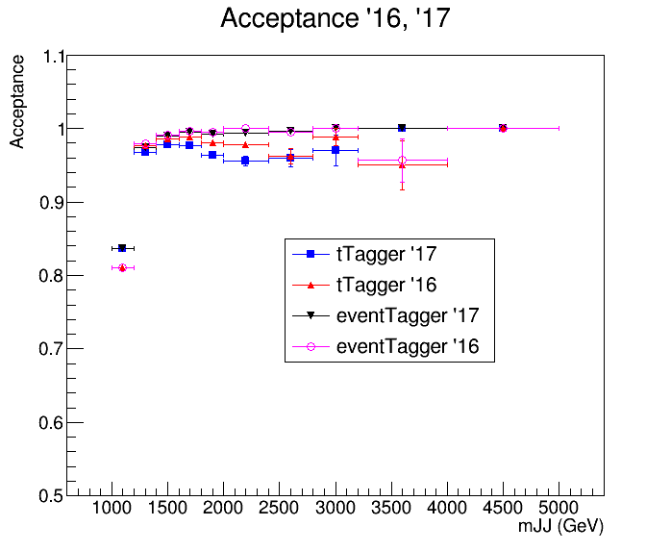
Acceptance and Efficiency CSVv2 2016 vs 2017
2016
2017

Slide 3
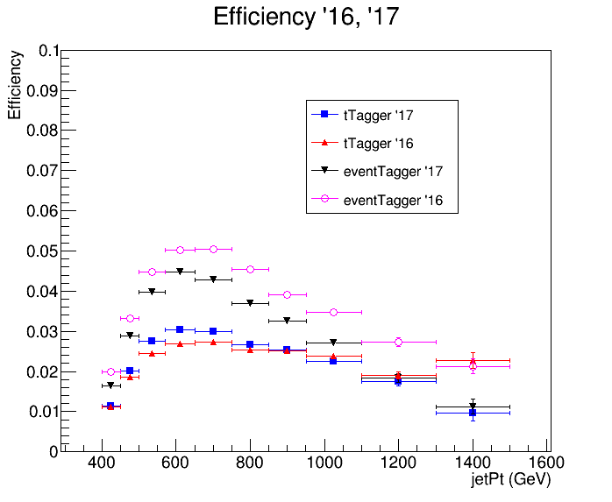
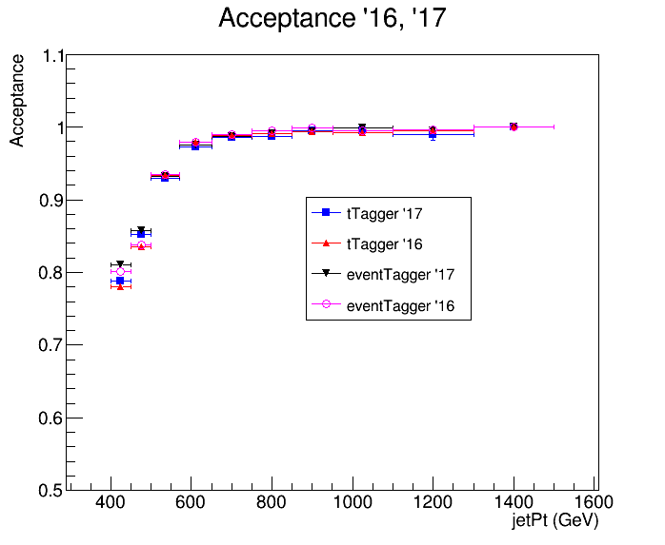
Acceptance and Efficiency CSVv2 2016 vs 2017
2016
2017

Slide 4
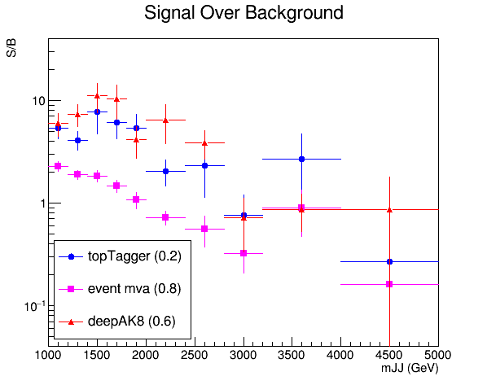
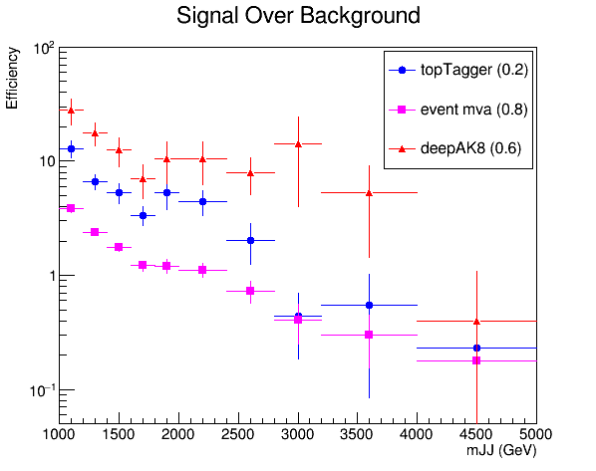
Signal over Background CSVv2 2016 vs 2017
2016
2017

Slide 5
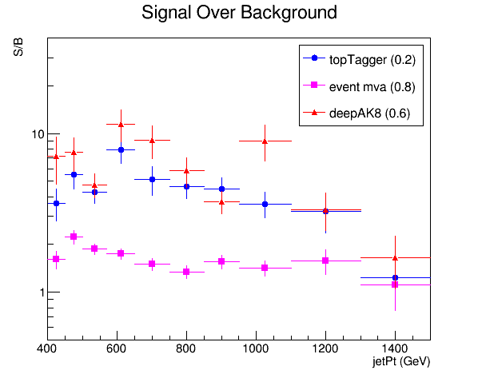
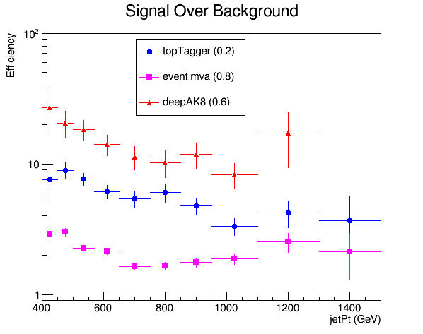
Signal over Background CSVv2 2016 vs 2017
2016
2017

Slide 6
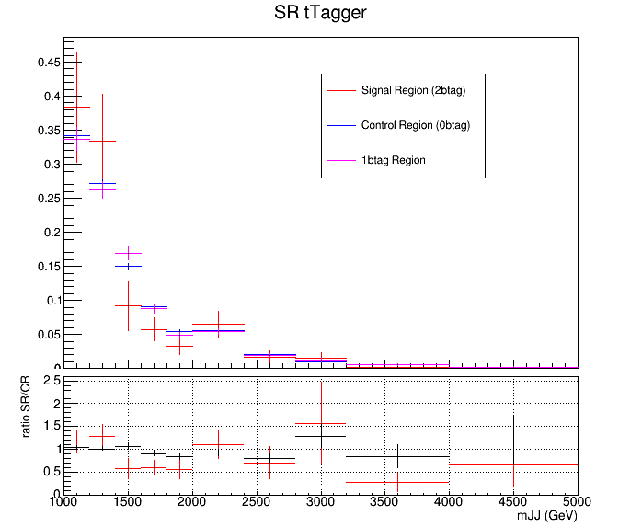
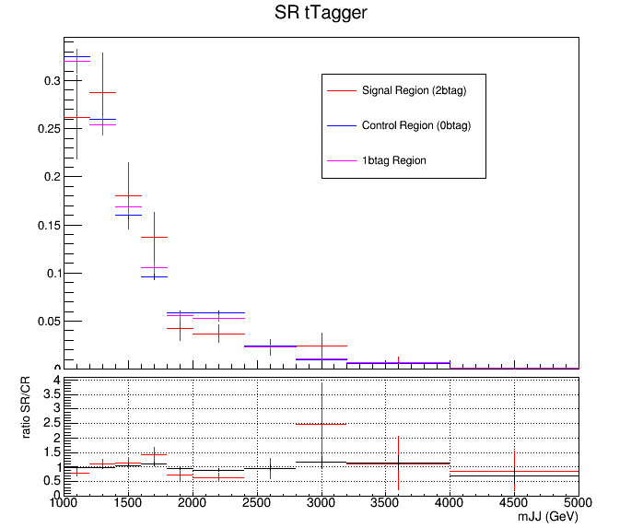
QCD Closure Tests CSVv2 2016 vs 2017
2016
2017

Slide 7
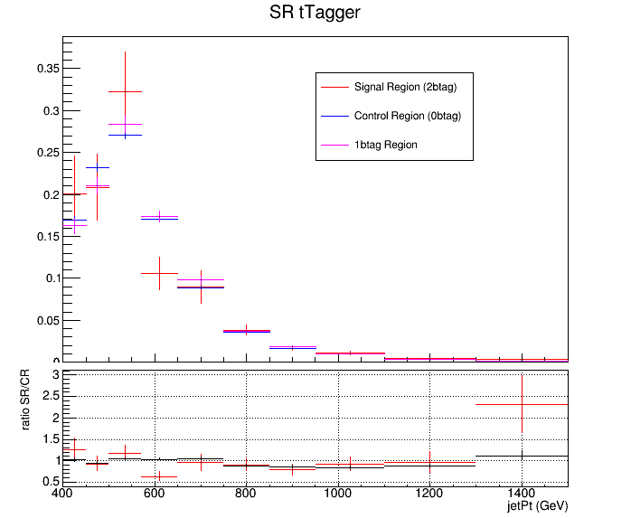
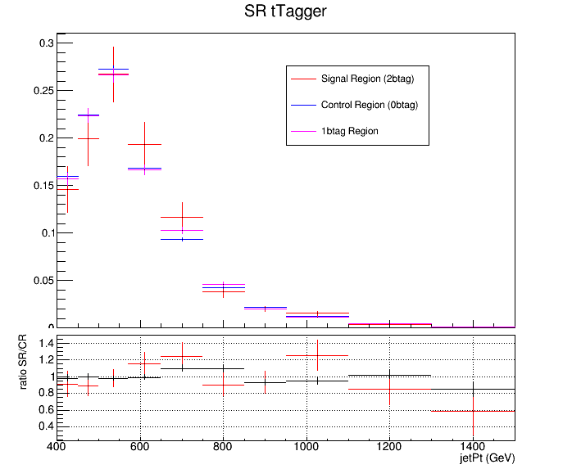
QCD Closure Tests CSVv2 2016 vs 2017
2016
2017

Slide 8
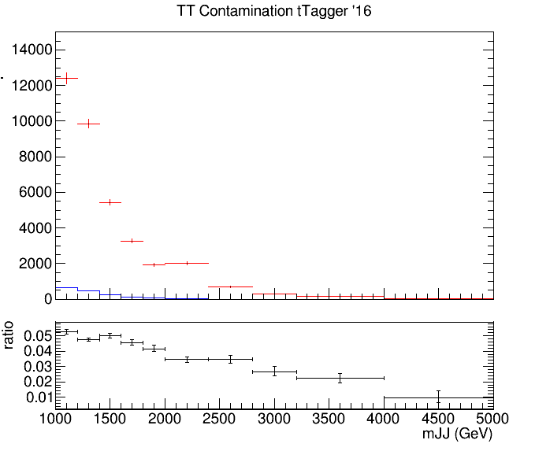
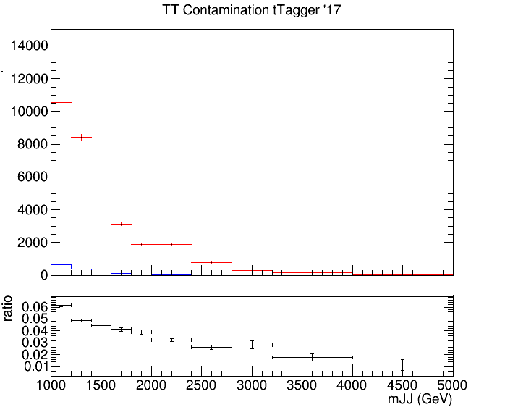
TT Contamination CSVv2 2016 vs 2017
2016
2017
Control Region QCD sample
Control Region QCD sample
Control Region TT sample
Control Region TT sample

Slide 9
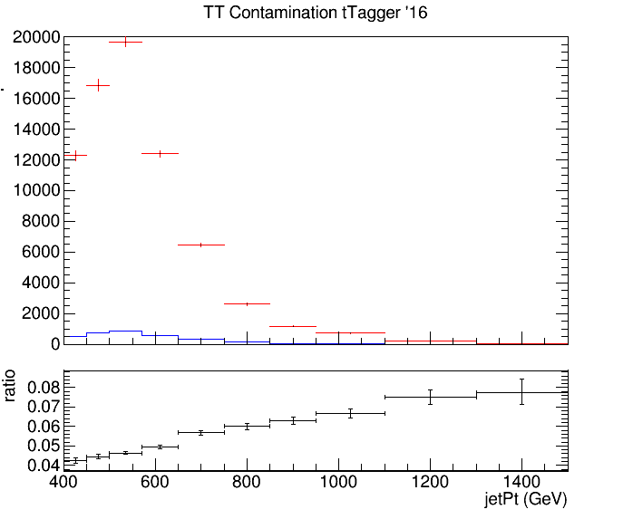
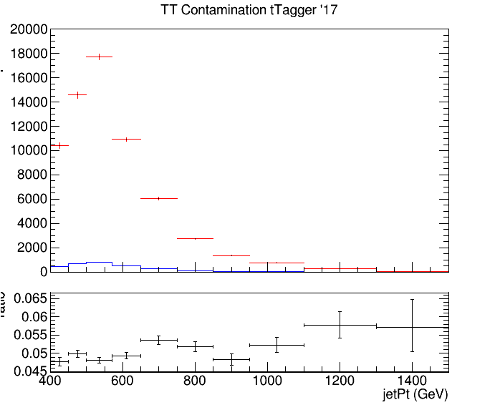
TT Contamination CSVv2 2016 vs 2017
2016
2017
Control Region QCD sample
Control Region QCD sample
Control Region TT sample
Control Region TT sample

Slide 10
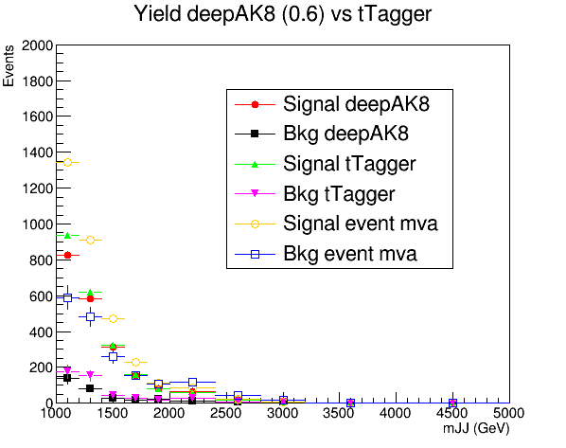

Yields CSVv2 2016 vs 2017
2016
2017

Slide 11
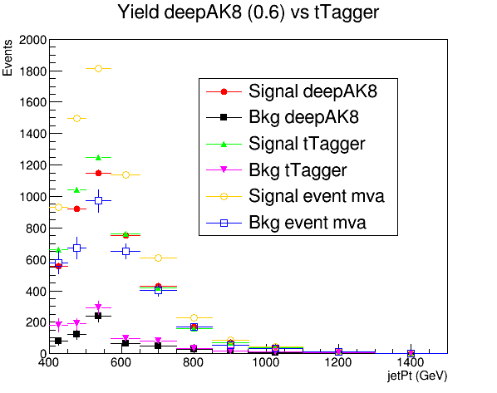
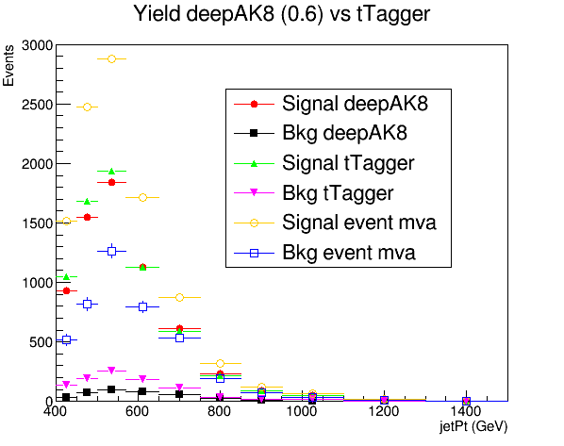
Yields CSVv2 2016 vs 2017
2016
2017

Slide 12
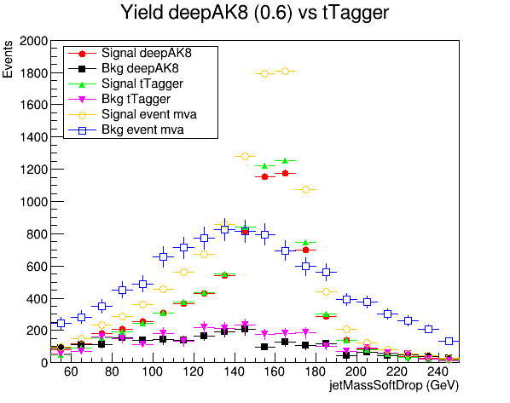
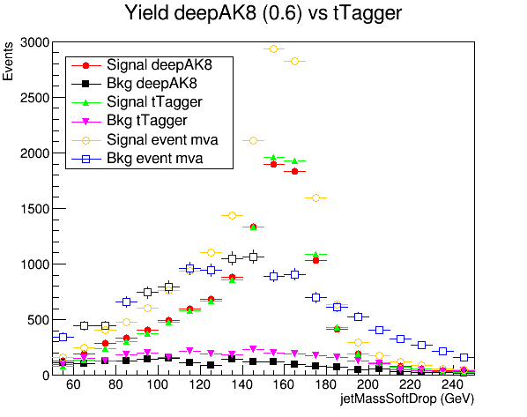
YieldsCSVv2 2016 vs 2017
2016
2017

Slide 13
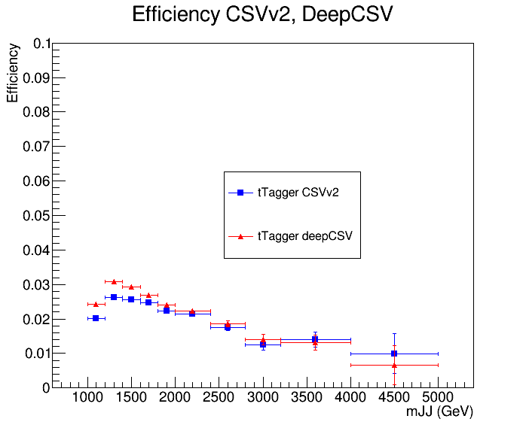
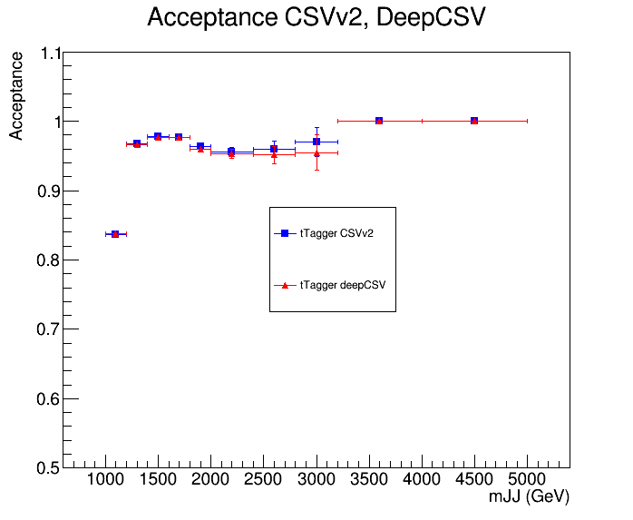
Efficiency and Acceptance CSVv2 vs deepCSV 2017
Efficiency
Acceptance

Slide 14
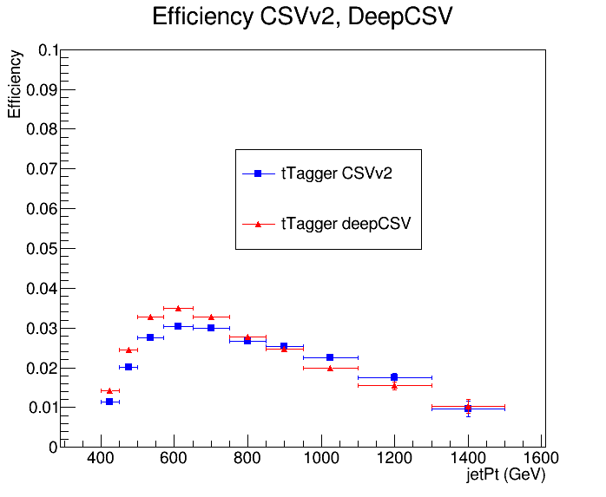
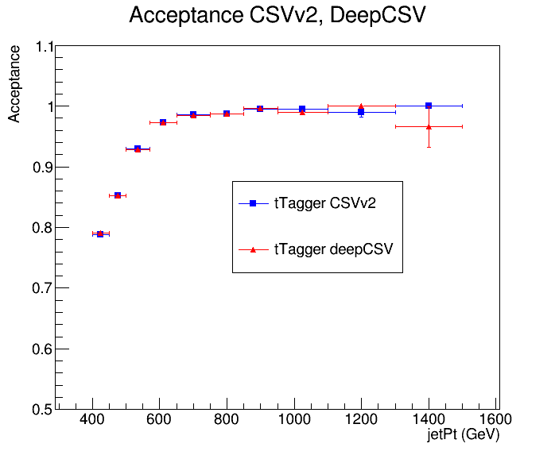
Efficiency and Acceptance CSVv2 vs deepCSV 2017
Efficiency
Acceptance

Slide 15
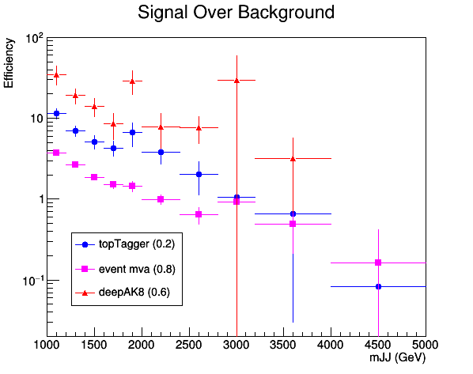
Signal over Background CSVv2 vs deepCSV 2017
deepCSV
CSVv2

Slide 16
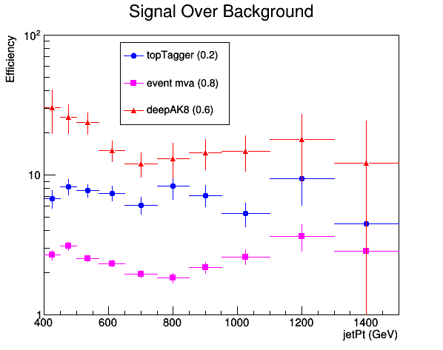
Signal over Background CSVv2 vs deepCSV 2017
deepCSV
CSVv2

Slide 17
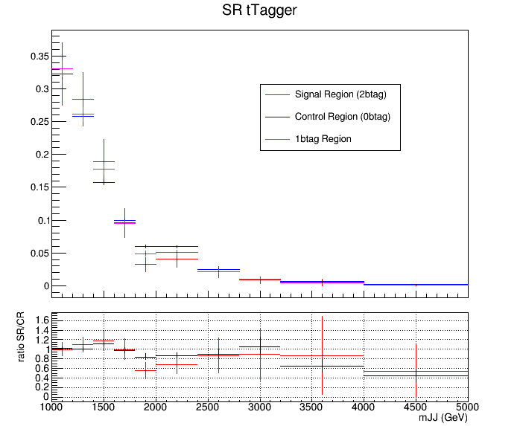

QCD Closure Tests CSVv2 vs deepCSV 2017
deepCSV
CSVv2

Slide 18
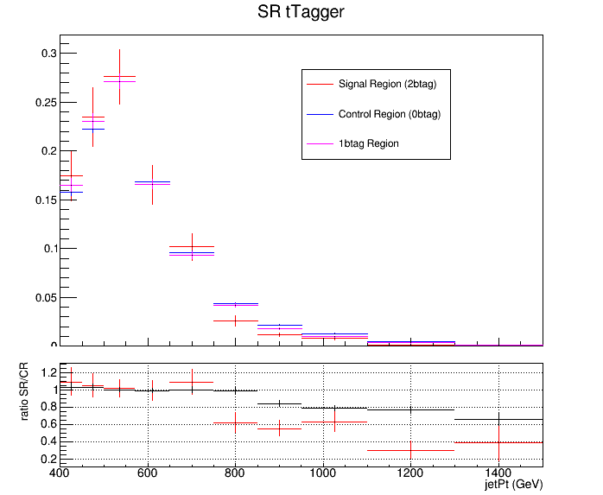

QCD Closure Tests CSVv2 vs deepCSV 2017
deepCSV
CSVv2

Slide 19
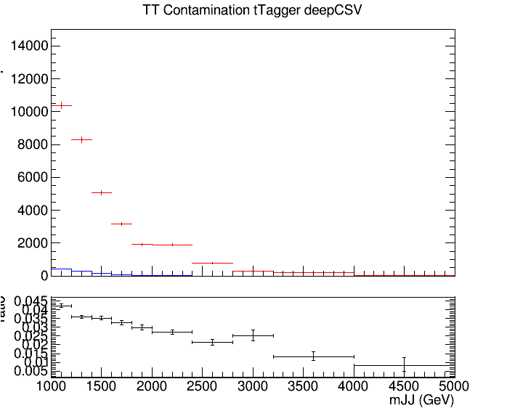
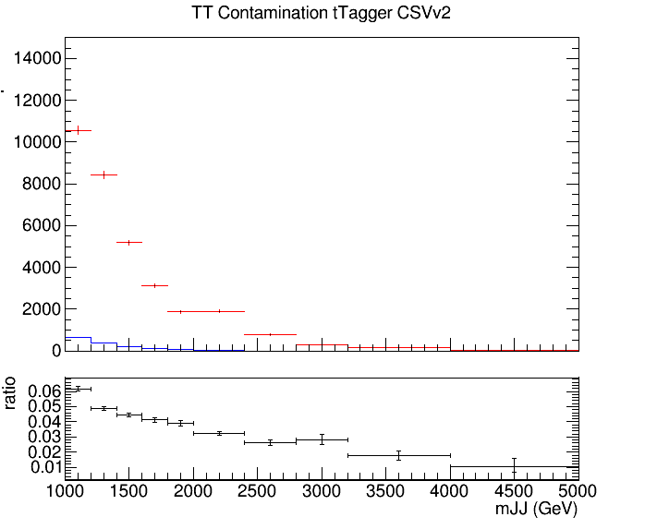
TT Contamination CSVv2 vs deepCSV 2017
deepCSV
CSVv2
Control Region QCD sample
Control Region QCD sample
Control Region TT sample
Control Region TT sample

Slide 20
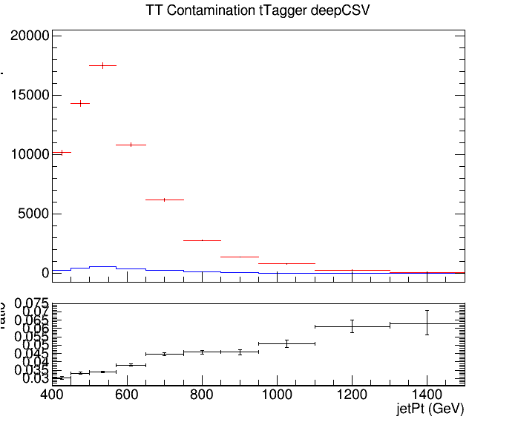

TT Contamination CSVv2 vs deepCSV 2017
deepCSV
CSVv2
Control Region QCD sample
Control Region QCD sample
Control Region TT sample
Control Region TT sample

Slide 21
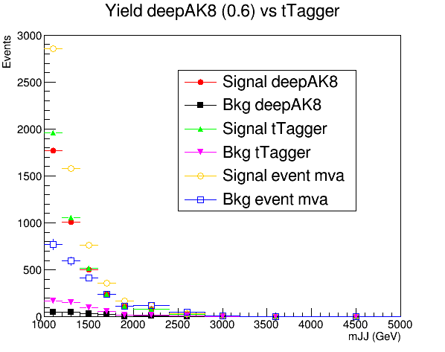
Yields CSVv2 vs deepCSV 2017
deepCSV
CSVv2

Slide 22
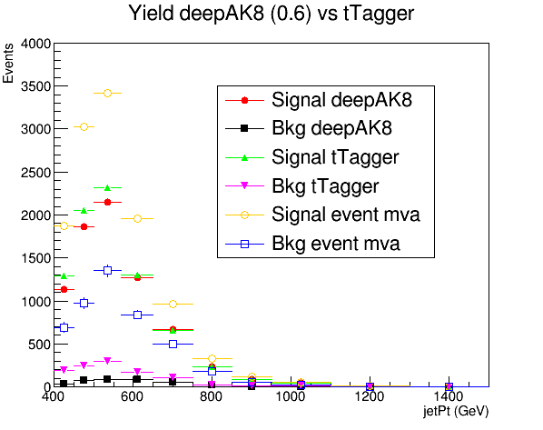
Yields CSVv2 vs deepCSV 2017
deepCSV
CSVv2

Slide 23
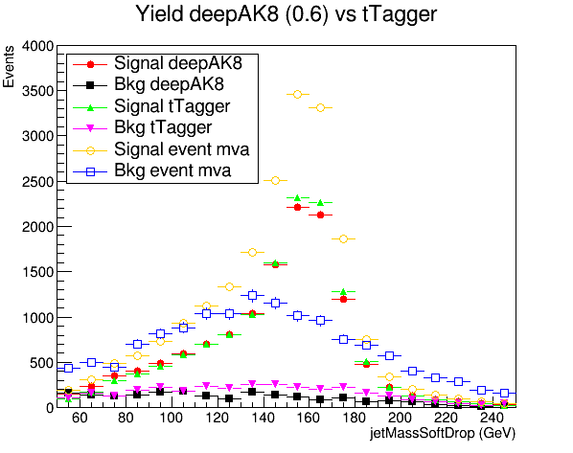
Yields CSVv2 vs deepCSV 2017
deepCSV
CSVv2

